Slide 1
The pace of geochemical processes: kinetics and diffusion
EART26201 | Principles of Geochemistry | Lecture 5
Part 1 | Introduction

Slide 2
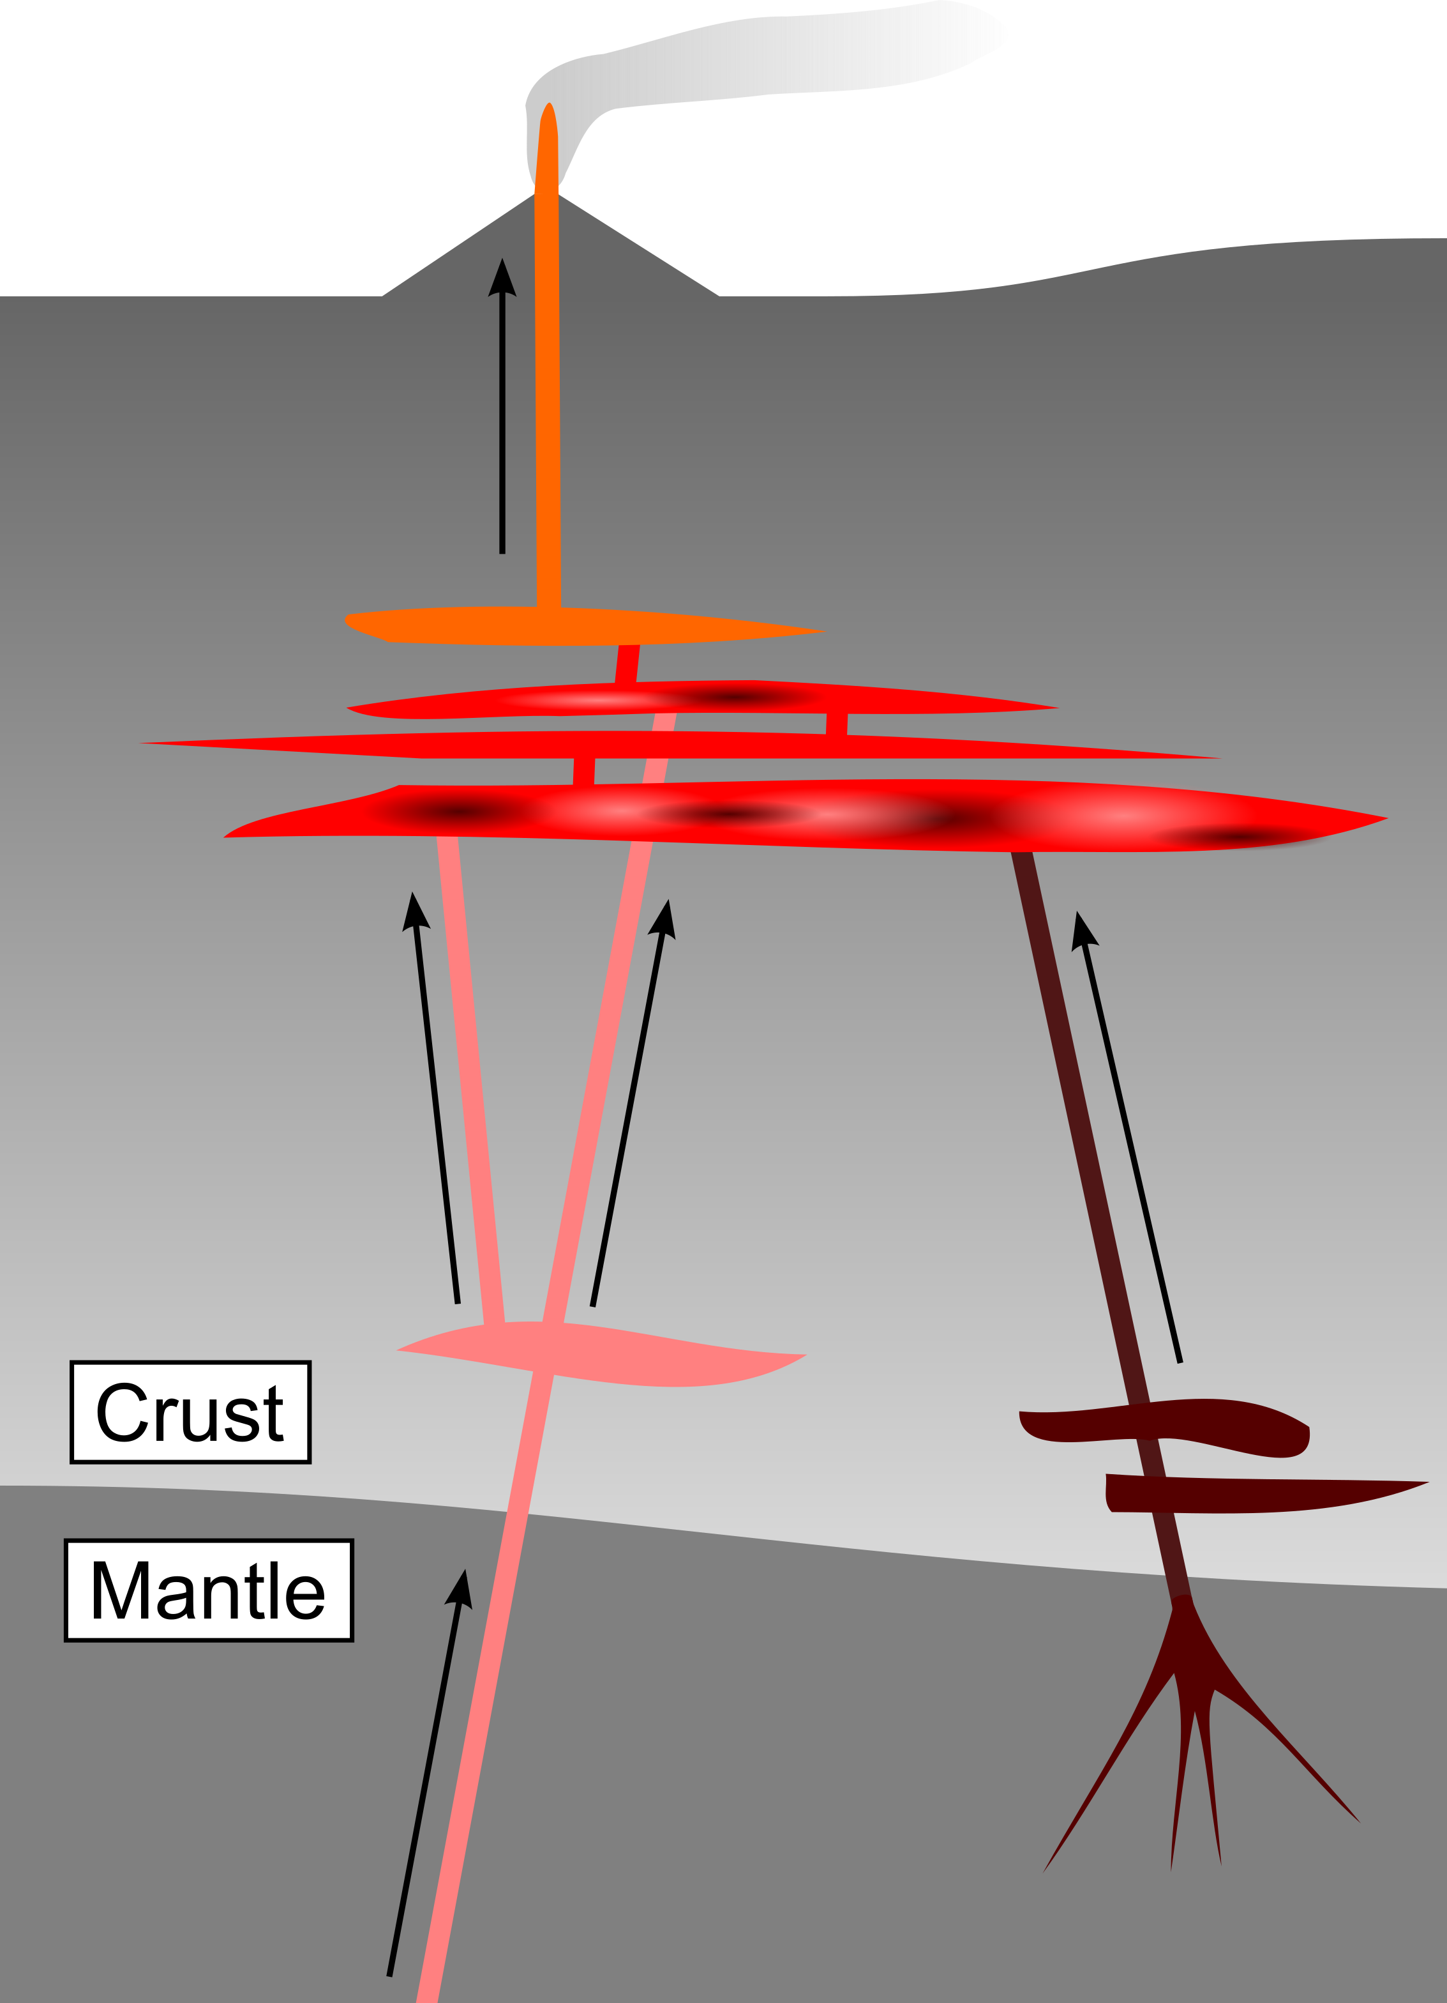
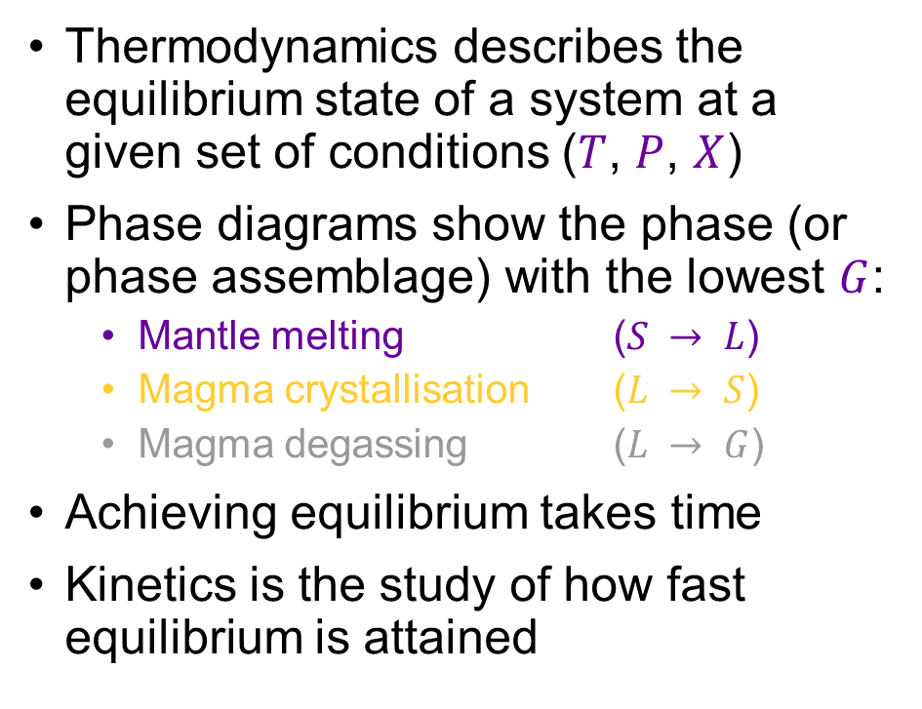
Thermodynamics versus kinetics
Thermodynamics describes the equilibrium state of a system at a given set of conditions ($T$, $P$, $X$)
Phase diagrams show the phase (or phase assemblage) with the lowest $G$:
  Mantle melting ($S → L$)
  Magma crystallisation ($L → S$)
  Magma degassing ($L → G$)
Achieving equilibrium takes time
Kinetics is the study of how fast equilibrium is attained
Pyroxenes in Lecture 4

Slide 3
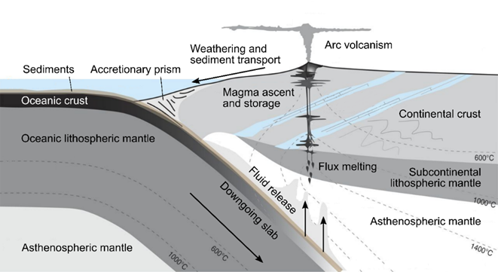
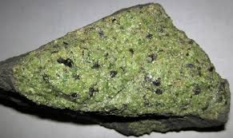
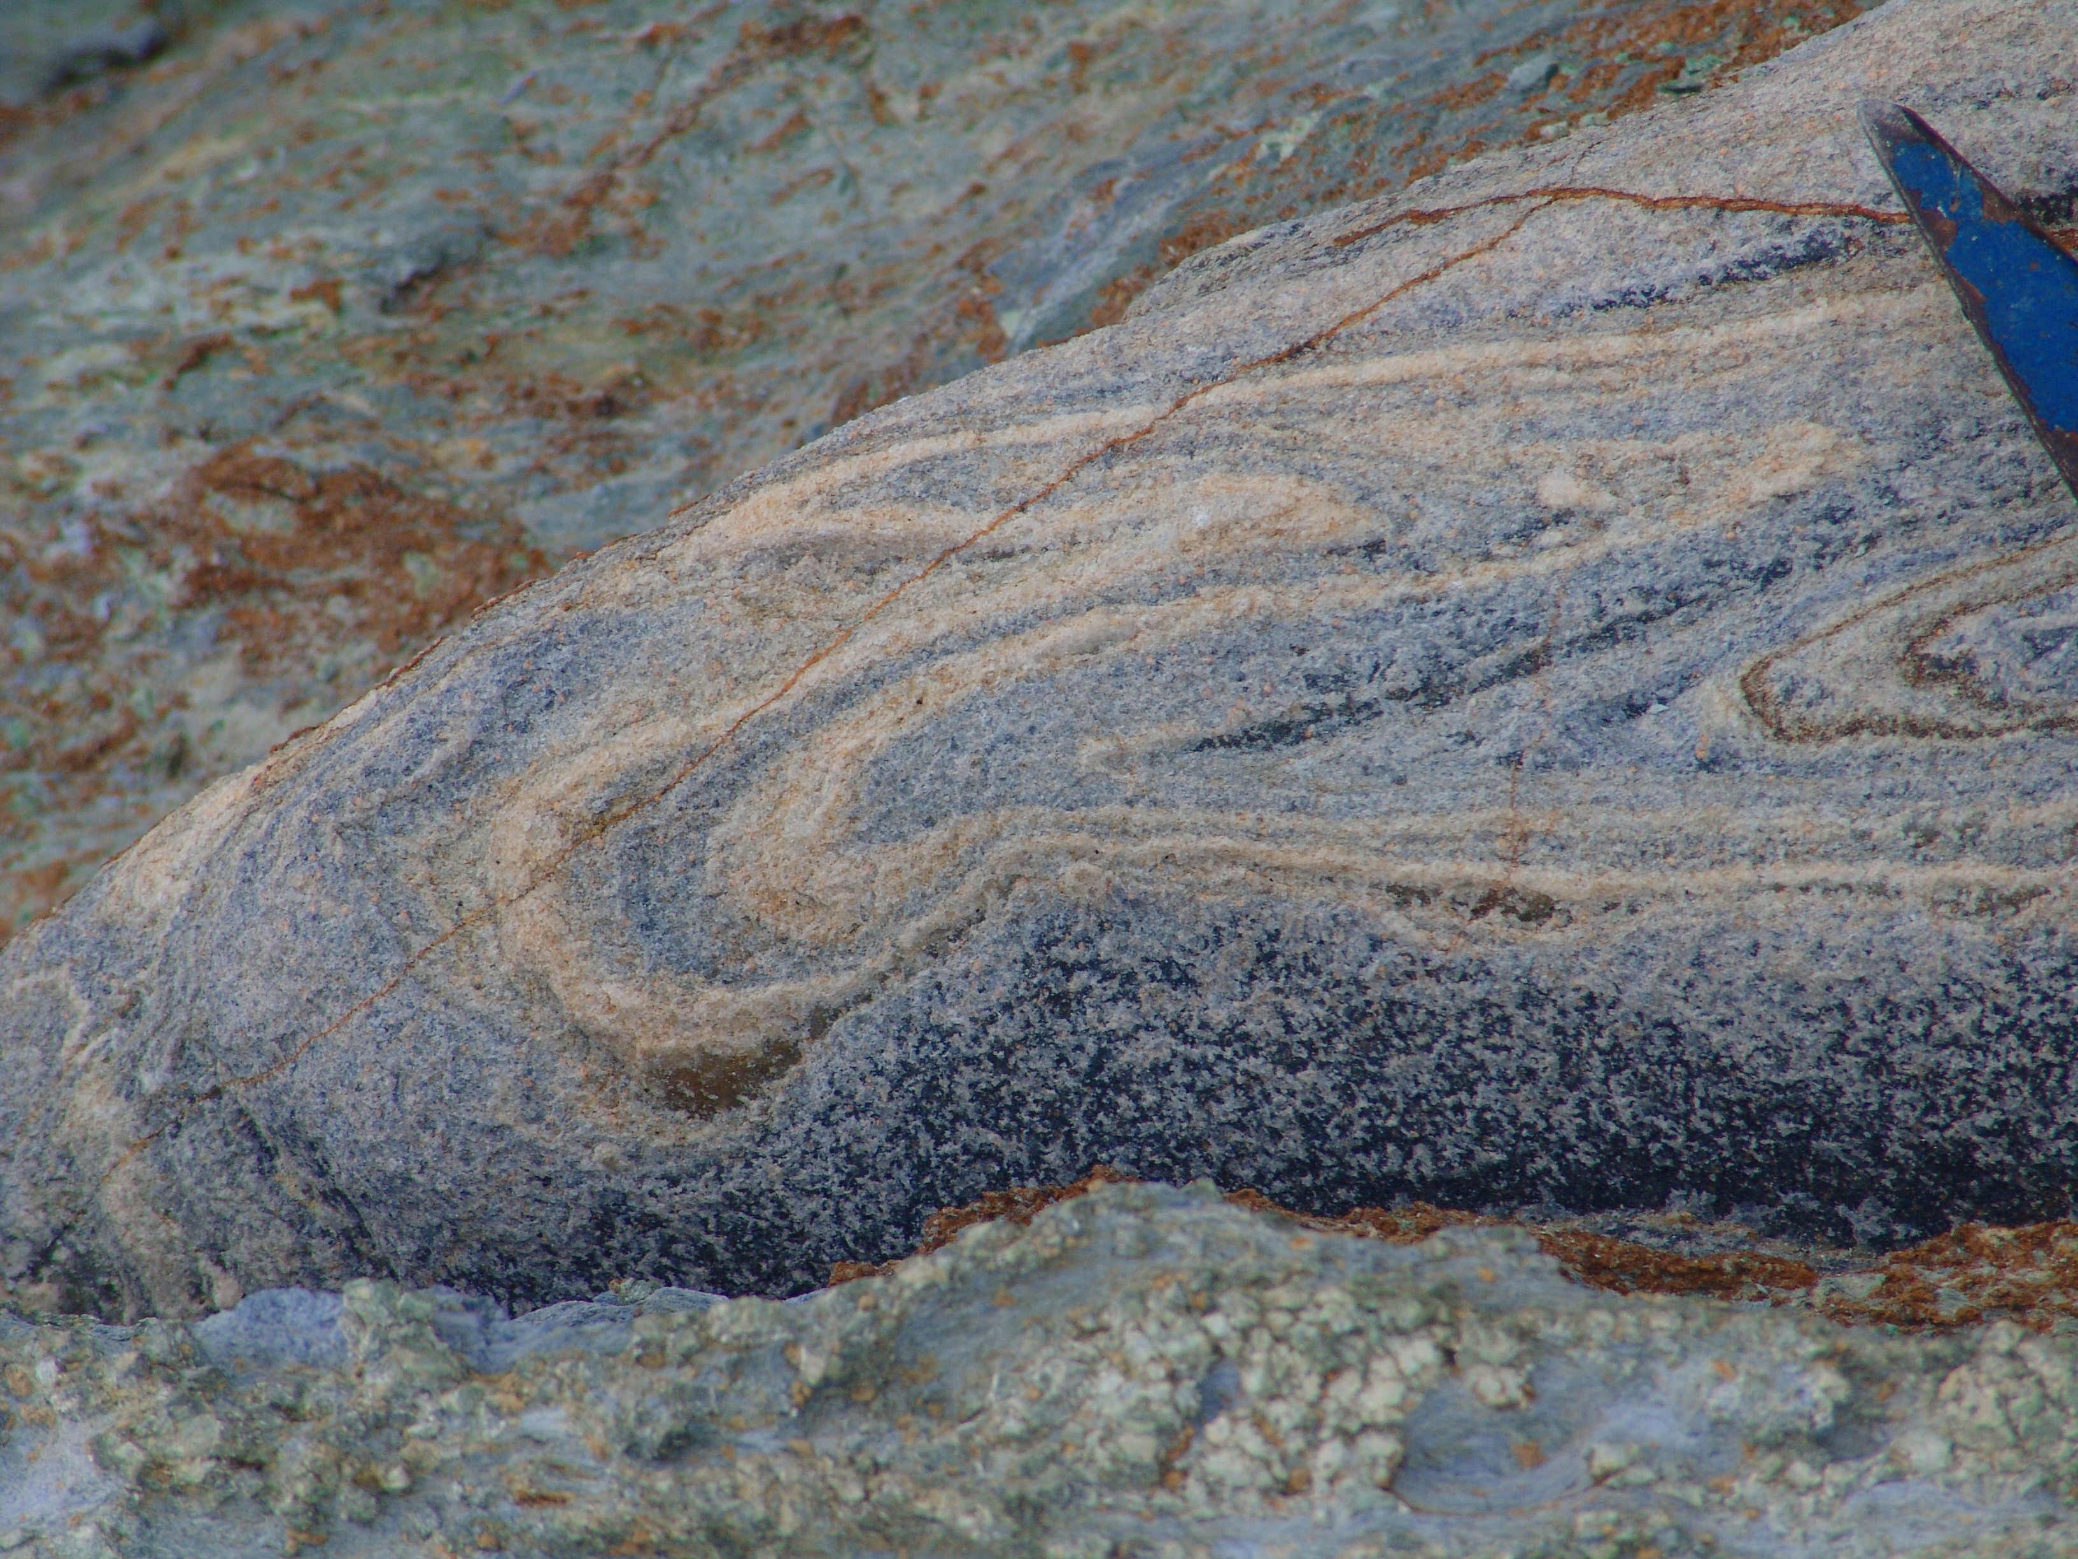



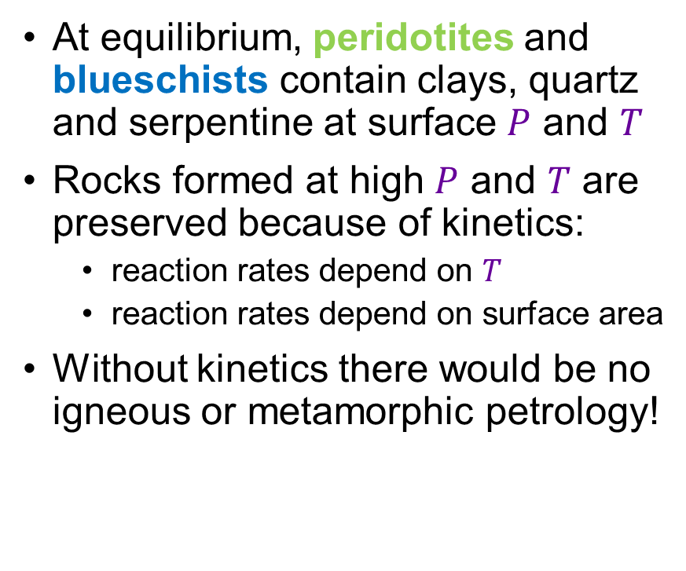
Kinetics in geological systems: the rock record
Mason et al. (2017)
At equilibrium, peridotites and blueschists contain clays, quartz and serpentine at surface $P$ and $T$
Rocks formed at high $P$ and $T$ are preserved because of kinetics:
  reaction rates depend on $T$
  reaction rates depend on surface area
Without kinetics there would be no igneous or metamorphic petrology!
Blueschist
Peridotite

Slide 4
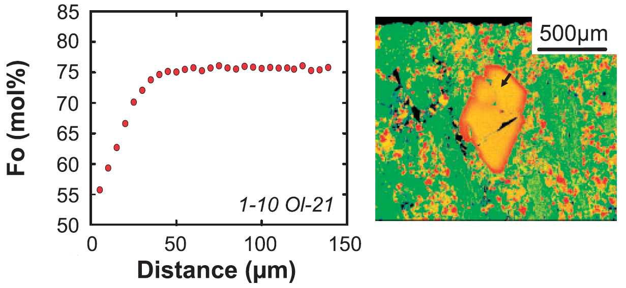
Kinetics in geological systems: timescales
Kinetics allows us to determine the timescales of geological processes
Partial attainment of equilibrium
Timescales of magma mixing and transport before volcanic eruptions
Kahl et al. (2015)

Slide 5
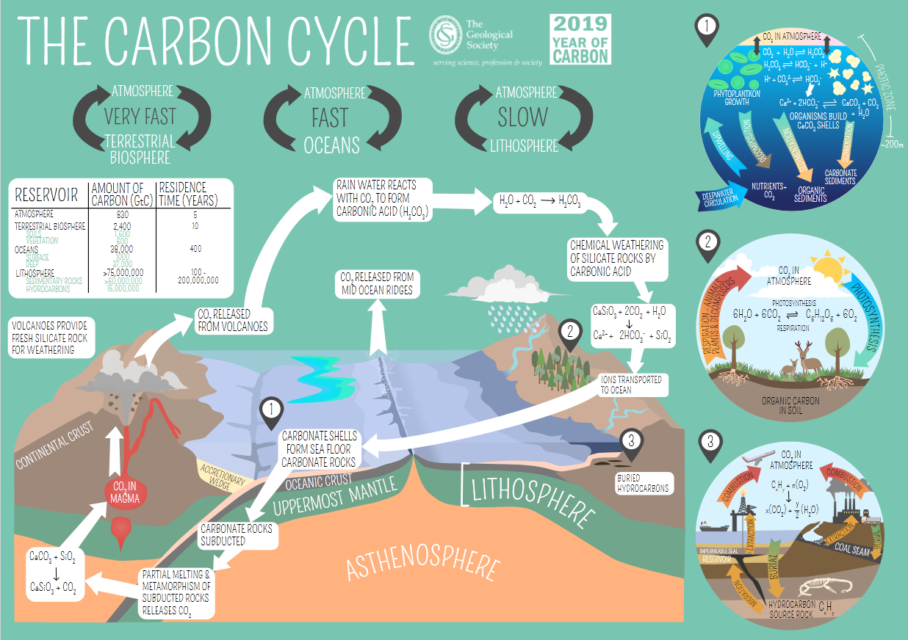

Kinetics in environmental systems: climate feedbacks
Kinetics controls the flux of carbon between reservoirs
The slow drawdown of carbon by silicate weathering with respect to the fast release of carbon by burning fossil fuels drives climate change
Not our focus, but the principles discussed are widely applicable

Slide 6
Lecture 5 synopsis
Synchronous
Part 1 | Introduction
Part 2 | Rate equations and reaction orders
Part 3 | Temperature and Arrhenian relationships
Part 4 | Diffusion and Fick’s laws
Part 5 | Estimating the timescales of magmatic processes
Further reading | Misra, Chapter 9 (detailed and mathematical)
Further reading | White, Chapter 5 (comprehensive but readable)

Slide 7
The pace of geochemical processes: kinetics and diffusion
EART26201 | Principles of Geochemistry | Lecture 5
Part 2 | Reaction rates and reaction orders

Slide 8
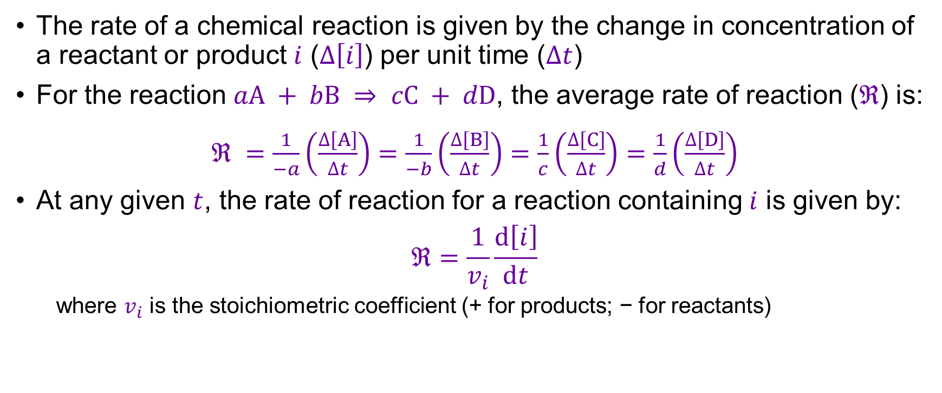
Reaction rates
The rate of a chemical reaction is given by the change in concentration of a reactant or product $i$ ($∆\left[i\right]$) per unit time ($∆t$)
For the reaction $aA + bB ⇒ cC + dD$, the average rate of reaction ($ℜ$) is:
$ℜ =\frac{1}{−a}\left(\frac{∆\left[A\right]}{∆t}\right)=\frac{1}{−b}\left(\frac{∆\left[B\right]}{∆t}\right)=\frac{1}{c}\left(\frac{∆\left[C\right]}{∆t}\right)$ $=\frac{1}{d}\left(\frac{∆\left[D\right]}{∆t}\right)$
At any given $t$, the rate of reaction for a reaction containing $i$ is given by:
$$ℜ=\frac{1}{v_{i}}\frac{d\left[i\right]}{dt}$$
  where $v_{i}$ is the stoichiometric coefficient (+ for products; − for reactants)
Instantaneous change

Slide 9
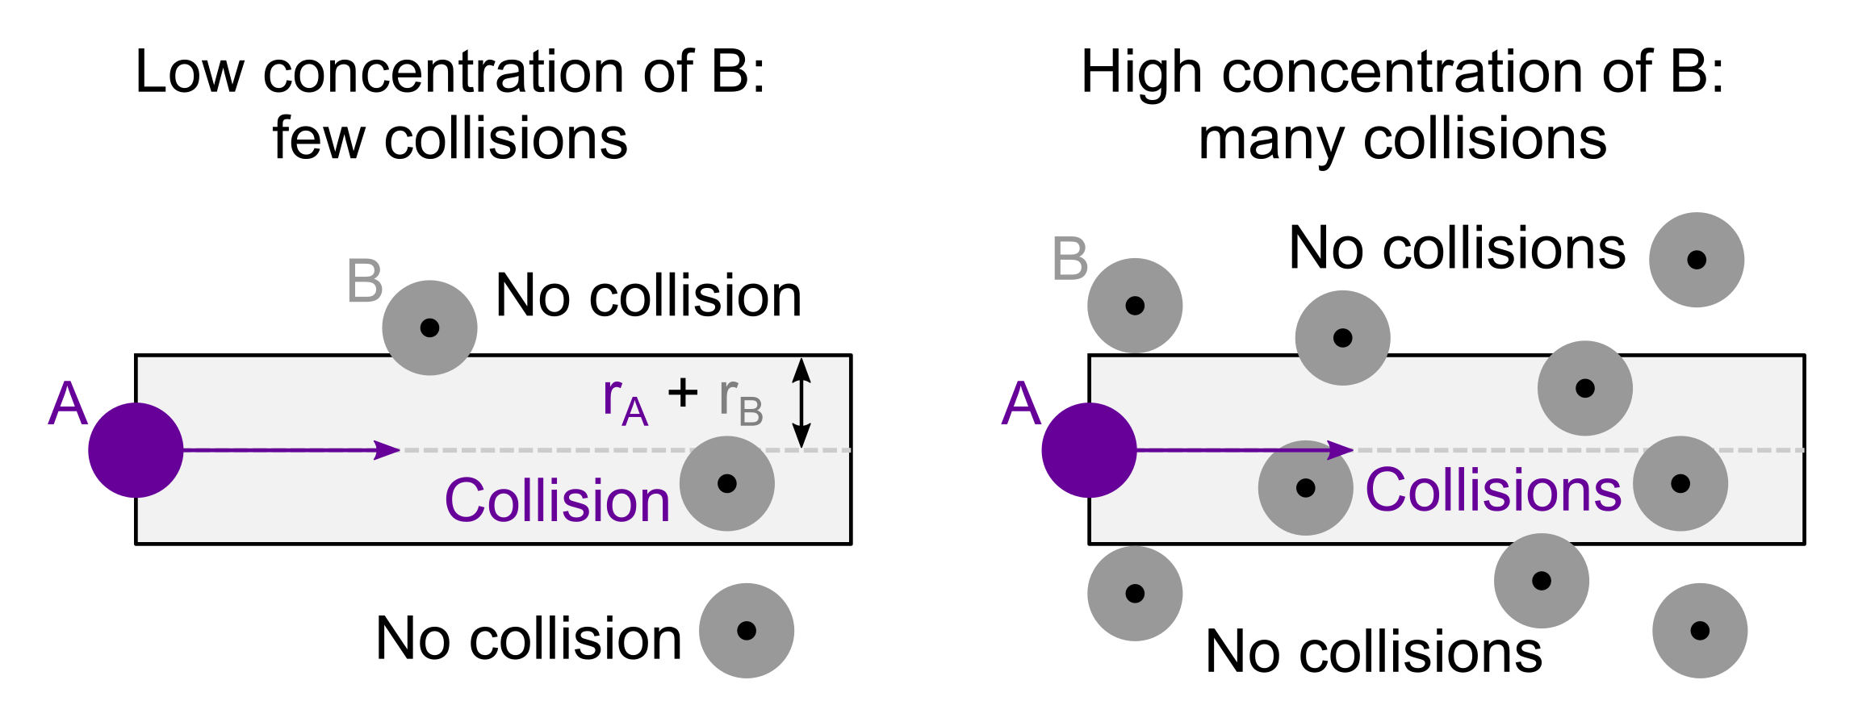
Factors determining reaction rates
Reactants must collide with sufficient energy for reactions to occur
The number of successful collisions can be increased by:
  Increasing the energy of the reactants: temperature and the Arrhenius relation (Part 3)
  Increasing the concentration of the reactants: rate laws and reaction orders

Slide 10
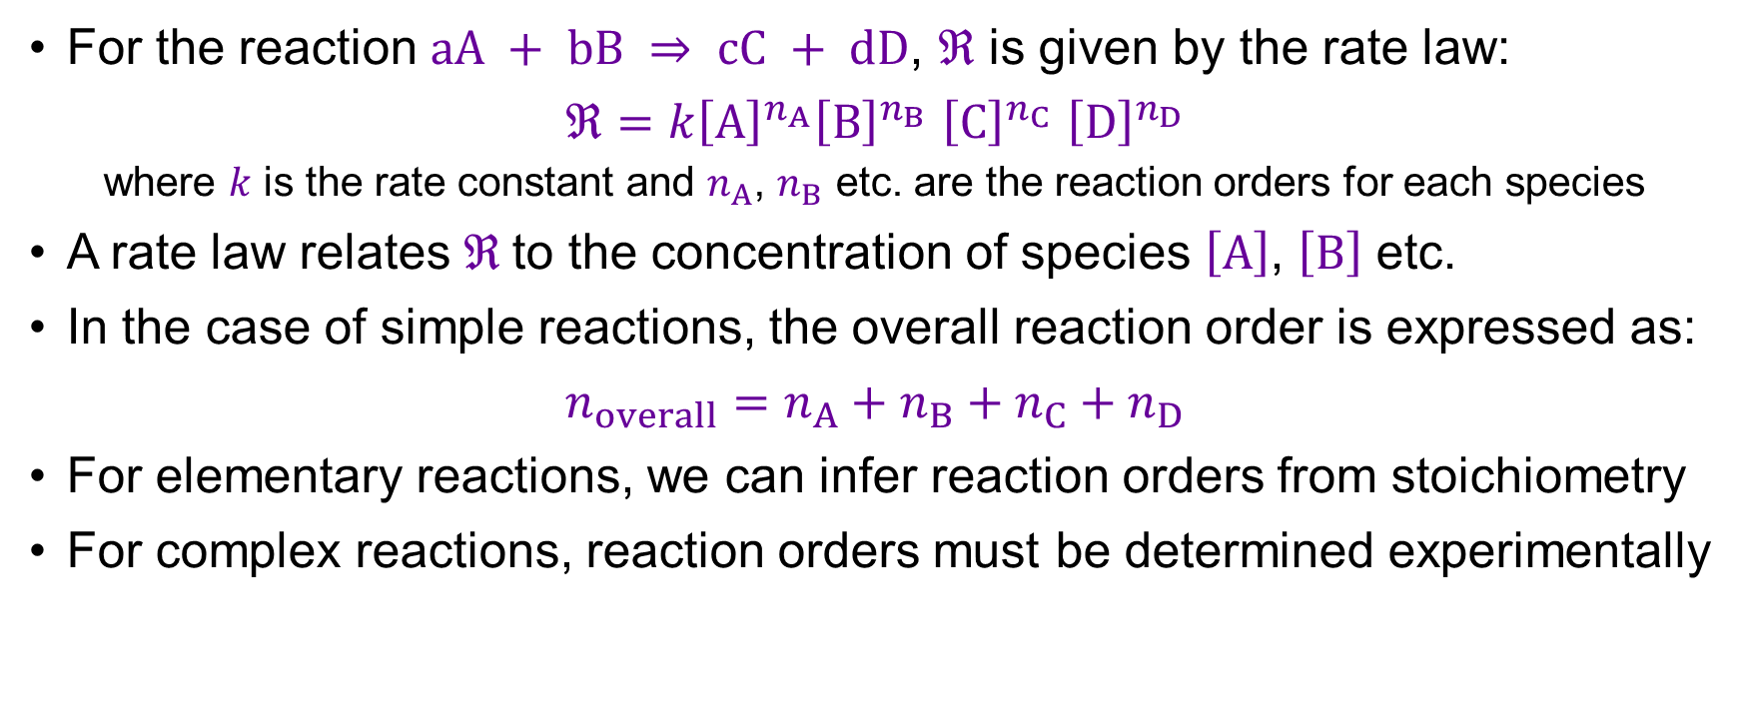
Rate laws and reaction orders
For the reaction $aA + bB ⇒ cC + dD$, $ℜ$ is given by the rate law:
$ℜ=k{\left[A\right]}^{n_{A}}{\left[B\right]}^{n_{B}}$ ${\left[C\right]}^{n_{C}}$ ${\left[D\right]}^{n_{D}}$
  where $k$ is the rate constant and $n_{A}$, $n_{B}$ etc. are the reaction orders for each species
A rate law relates $ℜ$to the concentration of species $\left[A\right]$, $\left[B\right]$ etc.
In the case of simple reactions, the overall reaction order is expressed as:
$$n_{overall}=n_{A}+n_{B}+n_{C}+n_{D}$$
For elementary reactions, we can infer reaction orders from stoichiometry
For complex reactions, reaction orders must be determined experimentally
Almost all geochemical reactions are complex, and many have multiple steps with distinct reaction orders

Slide 11
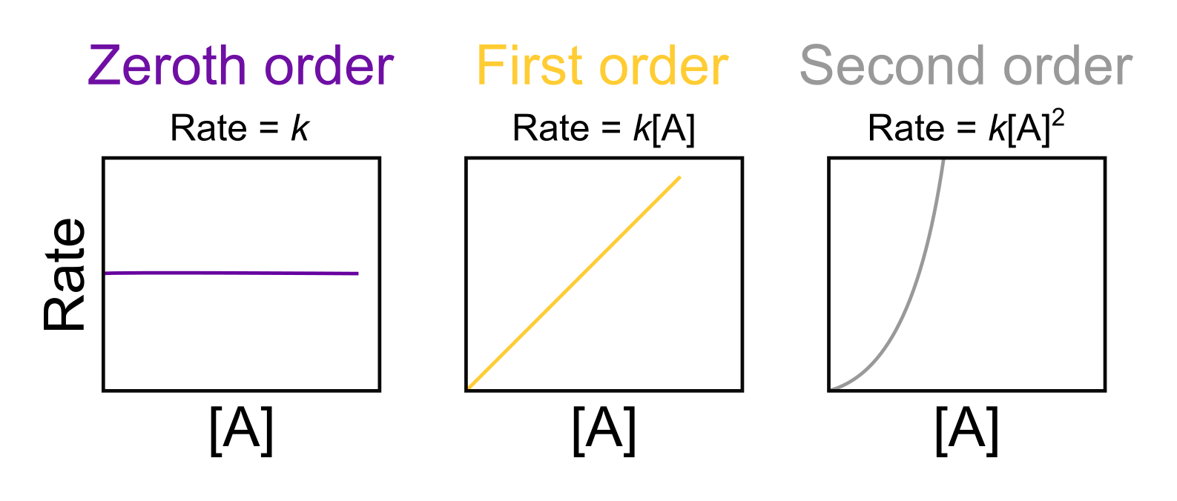
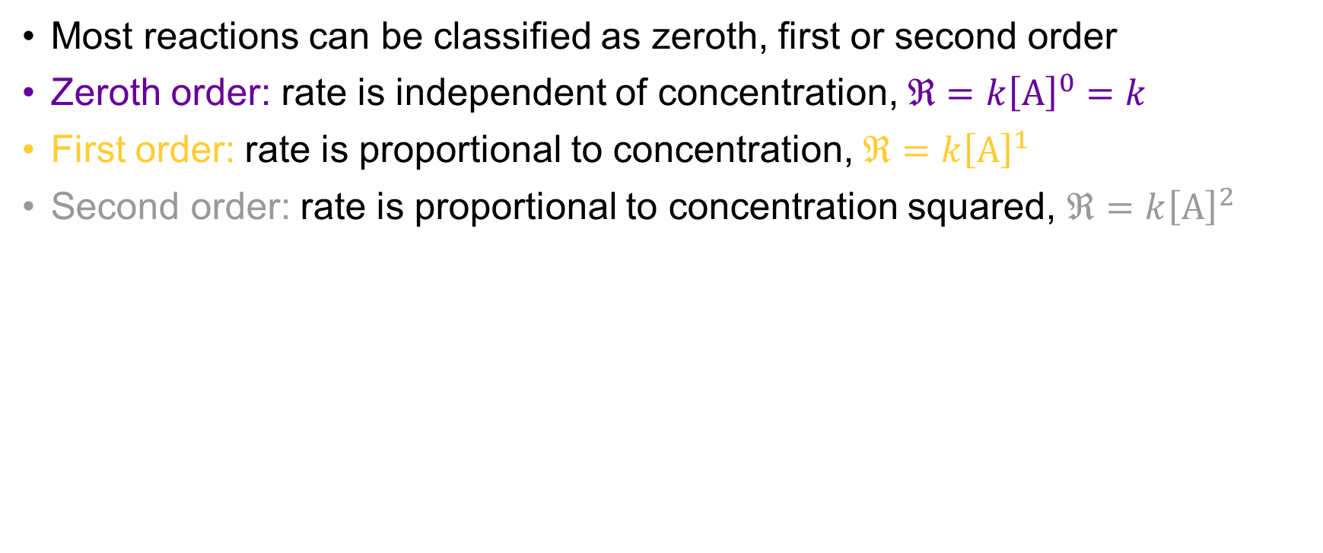
Types of reaction order
Most reactions can be classified as zeroth, first or second order
Zeroth order: rate is independent of concentration, $ℜ=k{\left[A\right]}^{0}=k$
First order: rate is proportional to concentration, $ℜ=k{\left[A\right]}^{1}$
Second order: rate is proportional to concentration squared, $ℜ=k{\left[A\right]}^{2}$

Slide 12
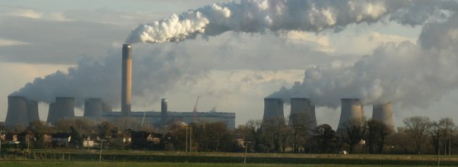
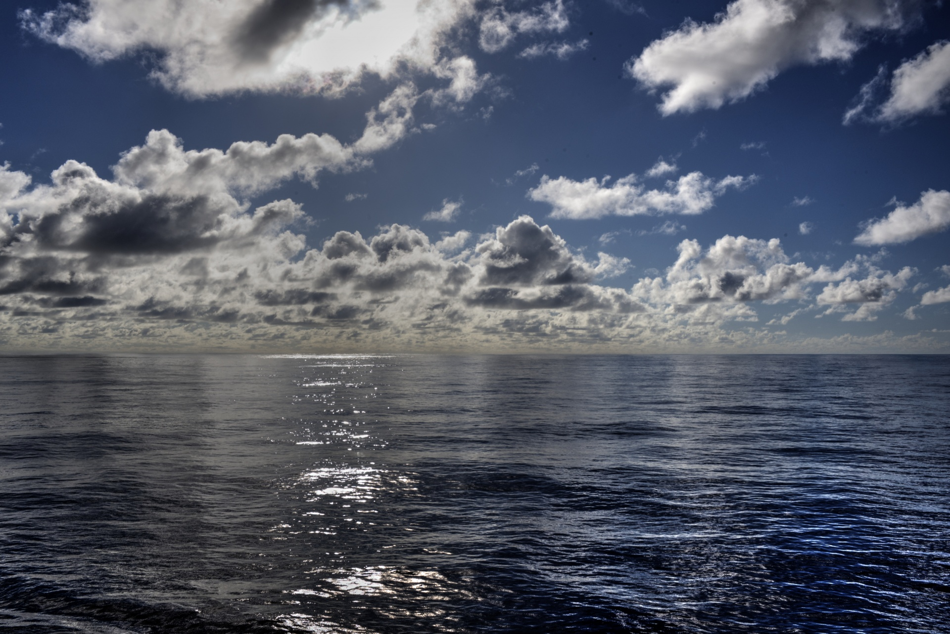
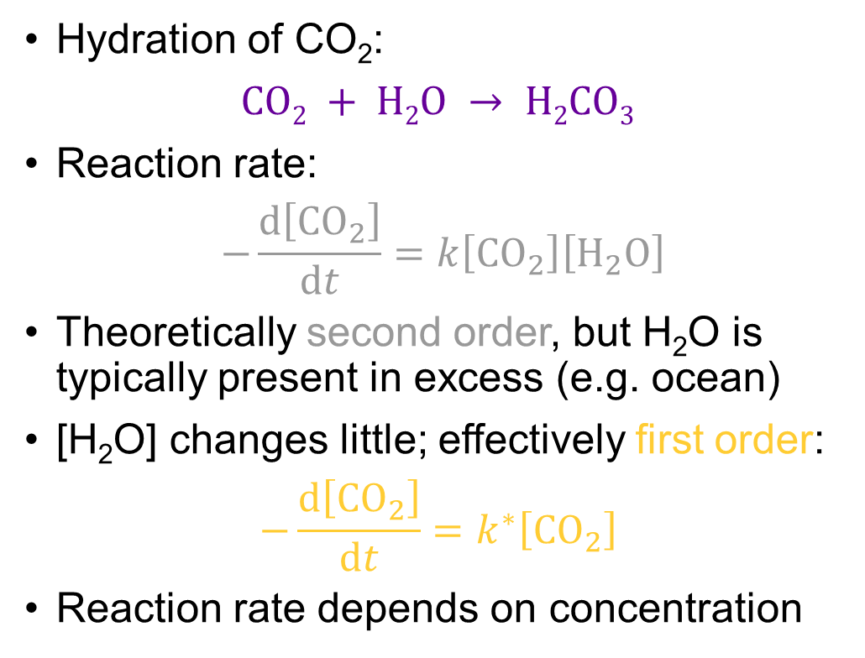
Reaction order example
Hydration of CO₂:
$$CO2 + H2O → H2CO3$$
Reaction rate:
$$−\frac{d\left[{CO}_{2}\right]}{dt}=k\left[{CO}_{2}\right]\left[H_{2}O\right]$$
Theoretically second order, but H₂O is typically present in excess (e.g. ocean)
[H₂O] changes little; effectively first order:
$$−\frac{d\left[{CO}_{2}\right]}{dt}=k^{∗}\left[{CO}_{2}\right]$$
Reaction rate depends on concentration

Slide 13
The pace of geochemical processes: kinetics and diffusion
EART26201 | Principles of Geochemistry | Lecture 5
Part 3 | Temperature and Arrhenian relationships

Slide 14
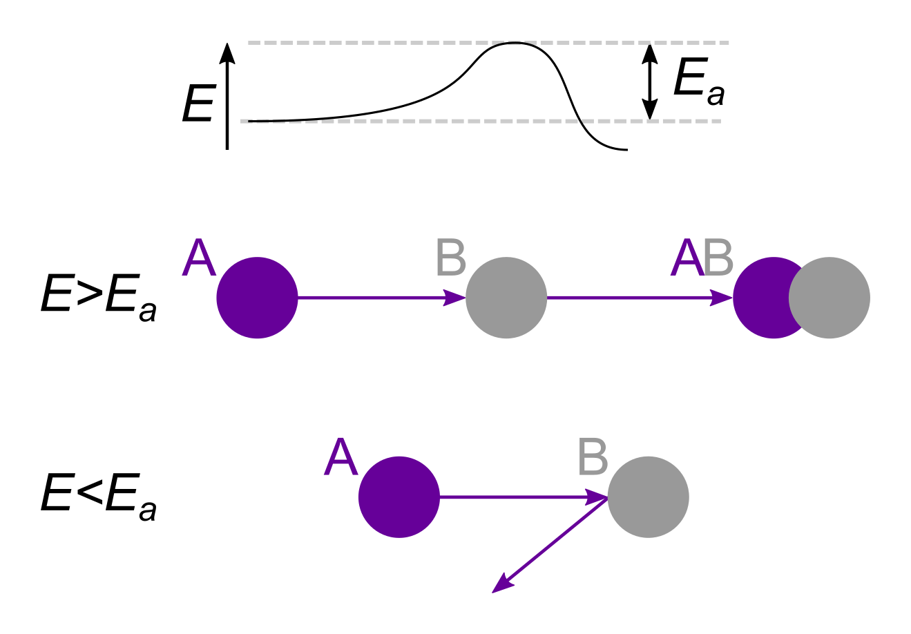
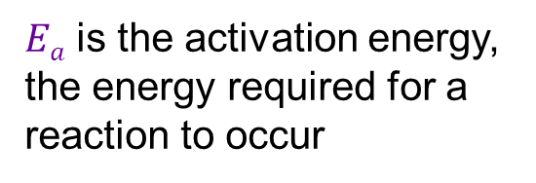
Factors determining reaction rates
Reactants must collide with sufficient energy for reactions to occur
The number of successful collisions can be increased by:
  Increasing the concentration of the reactants: rate laws and reaction orders (Part 2)
  Increasing the energy of the reactants: temperature and Arrhenian relationships
$Ea$ is the activation energy, the energy required for a reaction to occur

Slide 15
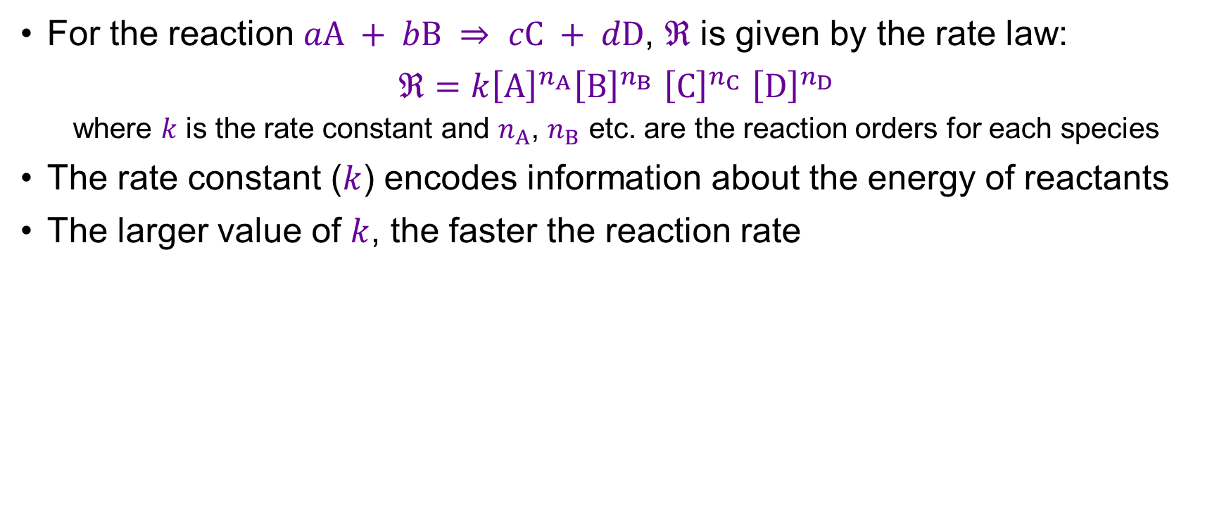
The rate constant
For the reaction $aA + bB ⇒ cC + dD$, $ℜ$ is given by the rate law:
$ℜ=k{\left[A\right]}^{n_{A}}{\left[B\right]}^{n_{B}}$ ${\left[C\right]}^{n_{C}}$ ${\left[D\right]}^{n_{D}}$
  where $k$ is the rate constant and $n_{A}$, $n_{B}$ etc. are the reaction orders for each species
The rate constant ($k$) encodes information about the energy of reactants
The larger value of $k$, the faster the reaction rate

Slide 16

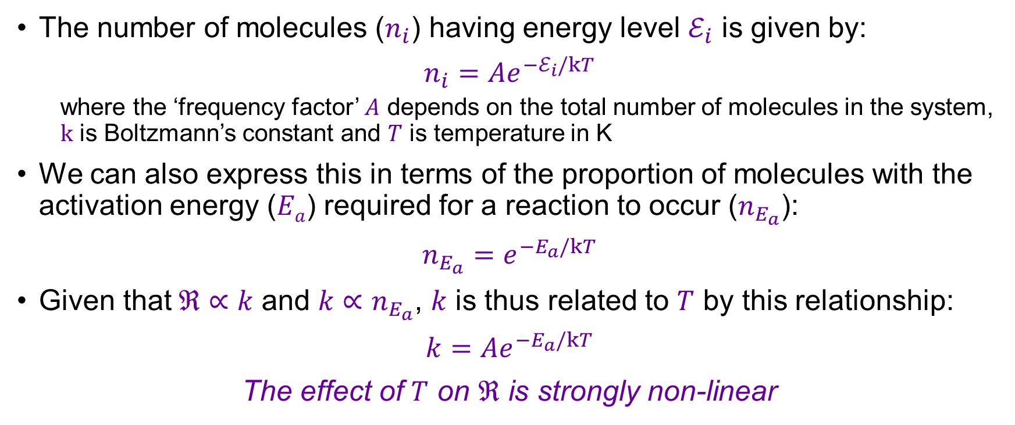
Energy and temperature: Arrhenian relationships
The number of molecules ($n_{i}$) having energy level $ℰ_{i}$ is given by:
$$n_{i}=Ae^{−ℰ_{i}/kT}$$
  where the ‘frequency factor’ $A$ depends on the total number of molecules in the system, $k$ is Boltzmann’s constant and $T$ is temperature in K
We can also express this in terms of the proportion of molecules with the activation energy ($Ea$) required for a reaction to occur ($n_{E_{a}}$):
$$n_{E_{a}}=e^{−E_{a}/kT}$$
Given that$ℜ∝k$ and $k∝n_{E_{a}}$, $k$ is thus related to $T$ by this relationship:
$$k={Ae}^{−E_{a}/kT}$$
The effect of $T$ on $ℜ$ is strongly non-linear
Reactions are much faster at higher $T$

Slide 17
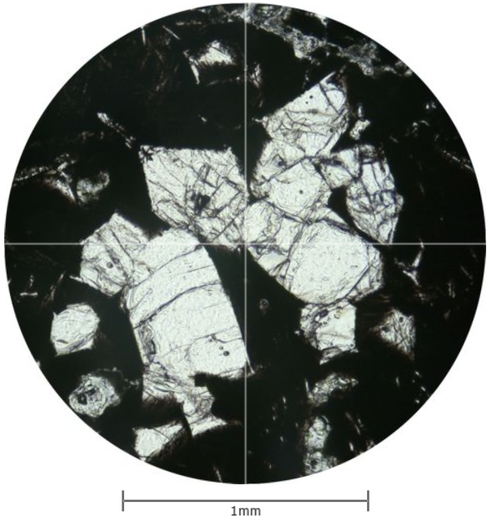
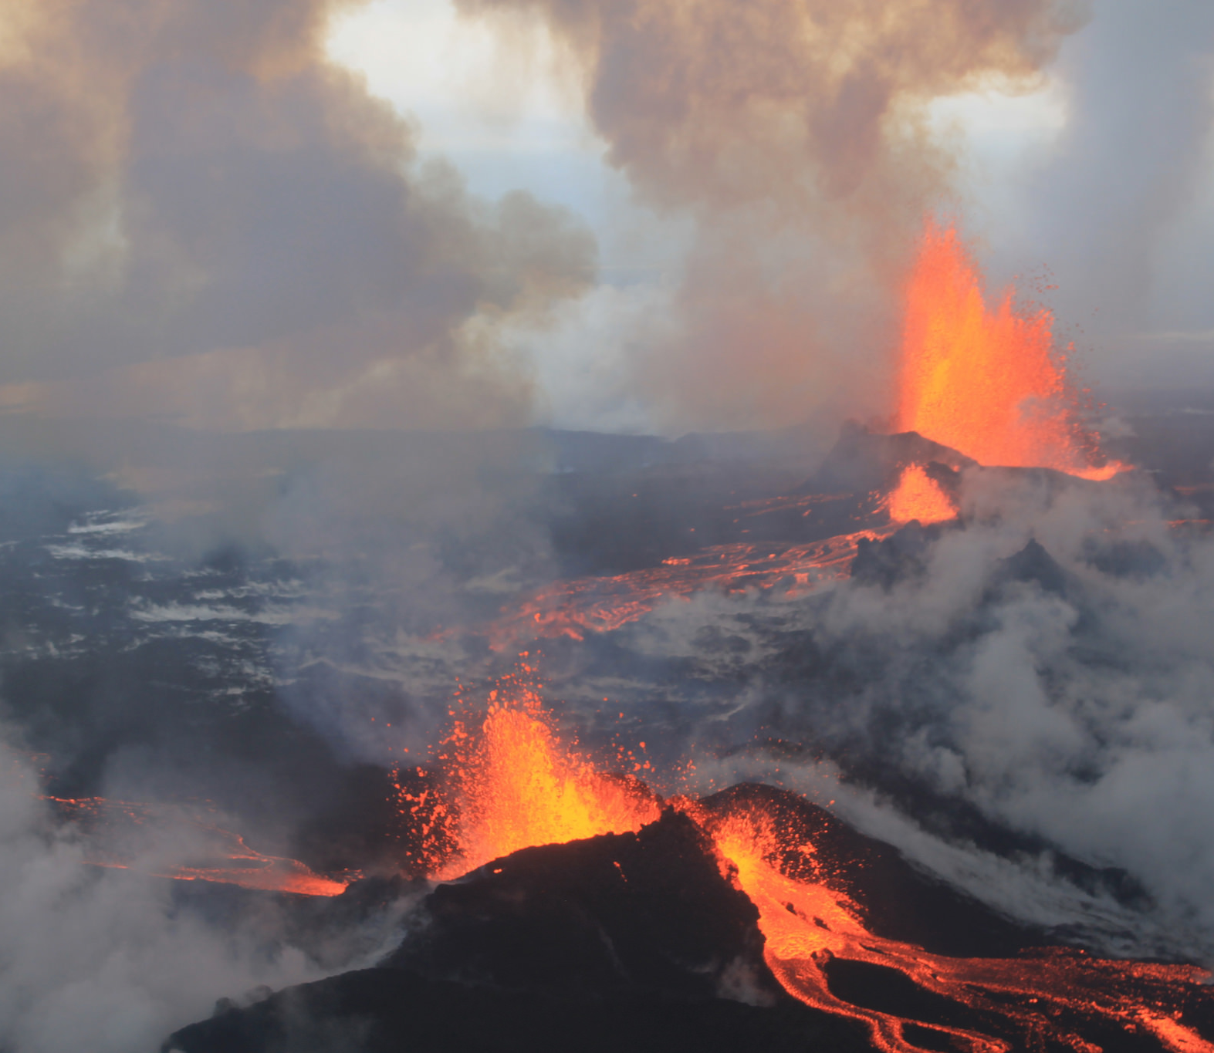
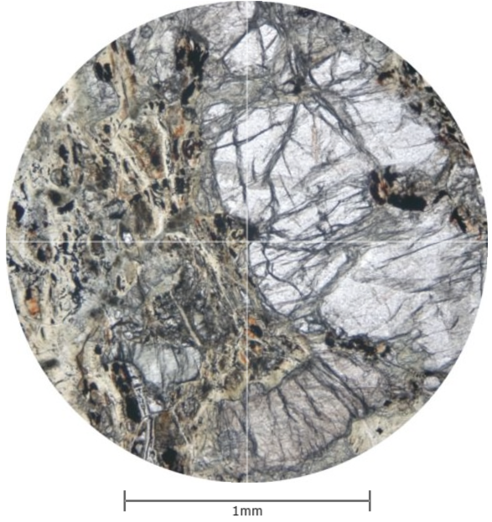
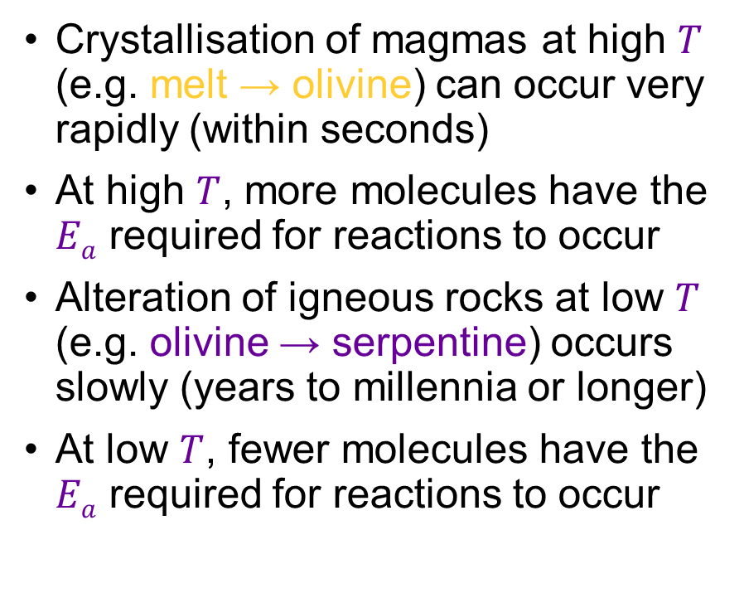
Implications for Arrhenian relationships
Crystallisation of magmas at high $T$ (e.g. melt → olivine) can occur very rapidly (within seconds)
At high $T$, more molecules have the $Ea$ required for reactions to occur
Alteration of igneous rocks at low $T$ (e.g. olivine → serpentine) occurs slowly (years to millennia or longer)
At low $T$, fewer molecules have the $Ea$ required for reactions to occur
https://www.virtualmicroscope.org

Slide 18
The pace of geochemical processes: kinetics and diffusion
EART26201 | Principles of Geochemistry | Lecture 5
Part 4 | Diffusion and Fick’s laws

Slide 19
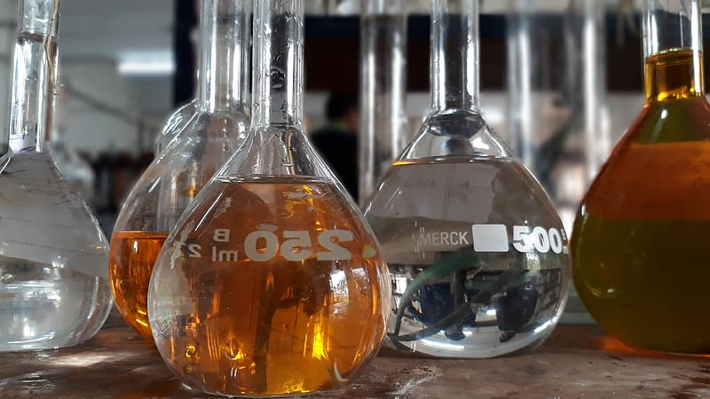
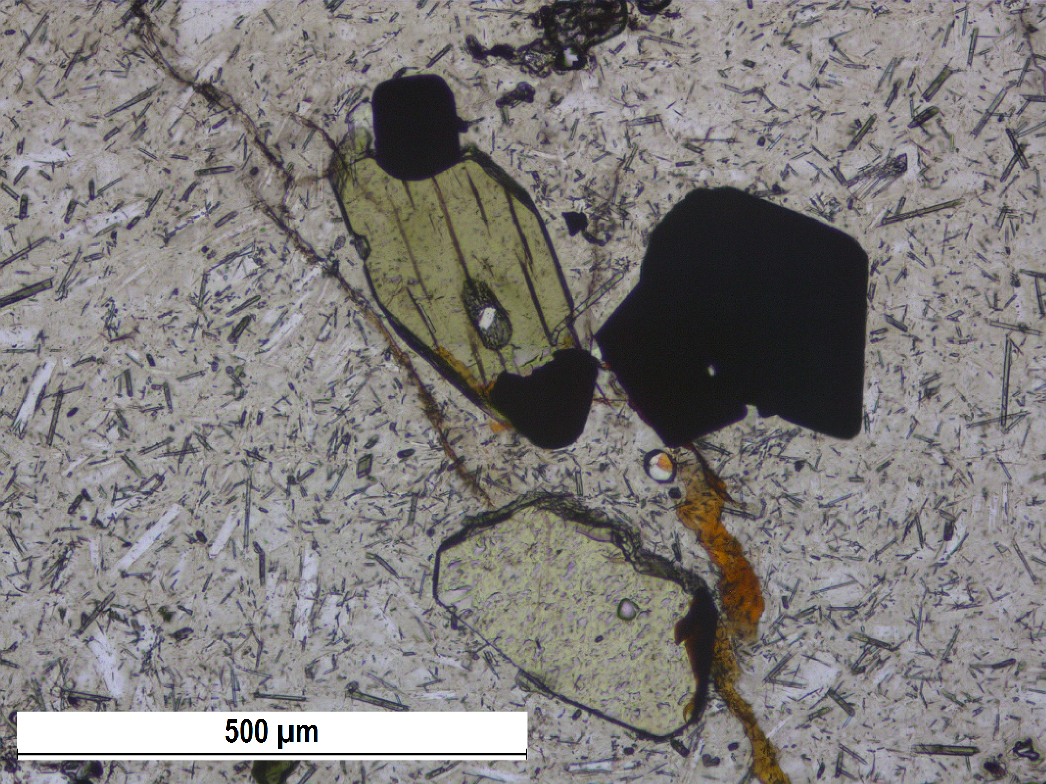
Mass transfer in geochemical systems
Theory assumes that reactants are always available for reaction, but…
Reactants in geochemical systems are often isolated from each other
Many reactions can only take place at the interfaces between phases
Phases are often locked within large reservoirs (oceans, the mantle etc.)
Mass transfer is thus often required for reactions to occur:
  Advection: physical bulk movement
  Diffusion: spontaneous movement down a concentration gradient

Slide 20
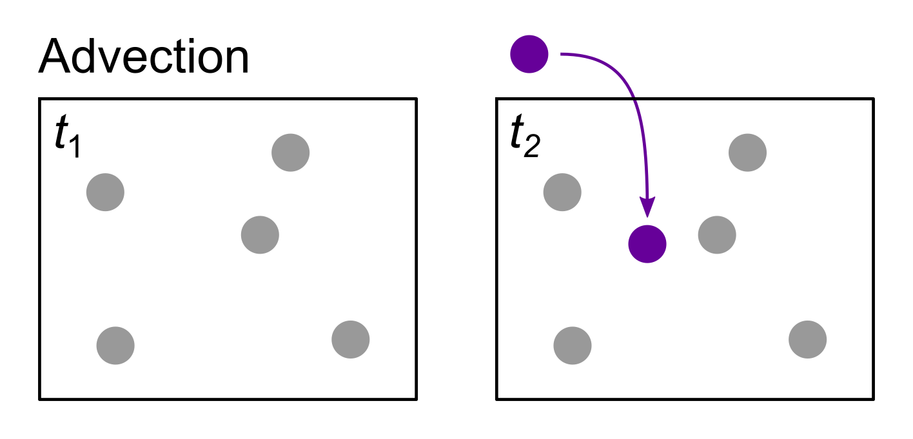
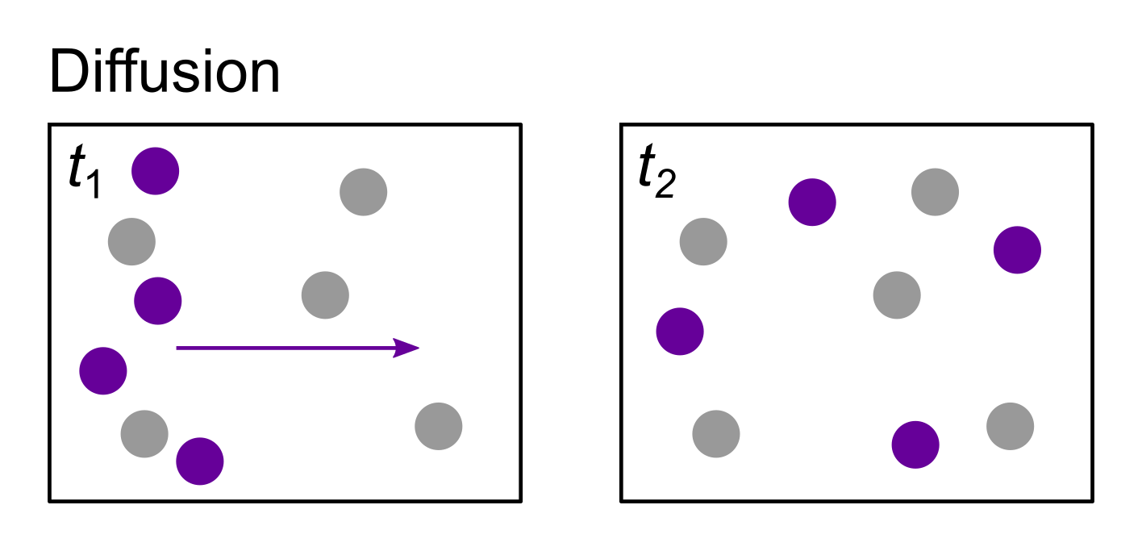
Advection versus diffusion
Advection
Reactants brought into contact by bulk physical movement (stirring)
External forces (e.g. gravity)
Diffusion
Reactants brought into contact by spontaneous movement down a concentration gradient
Diffusion occurs all the time, but is only visible when homogenising a concentration gradient

Slide 21
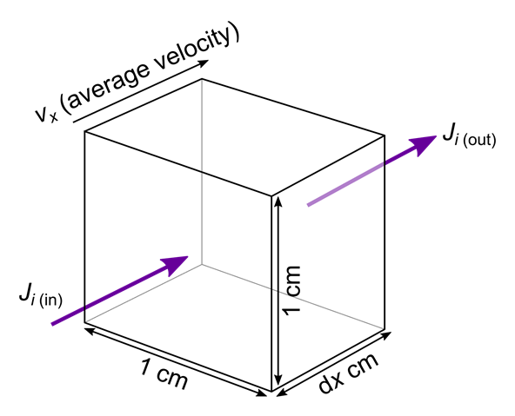
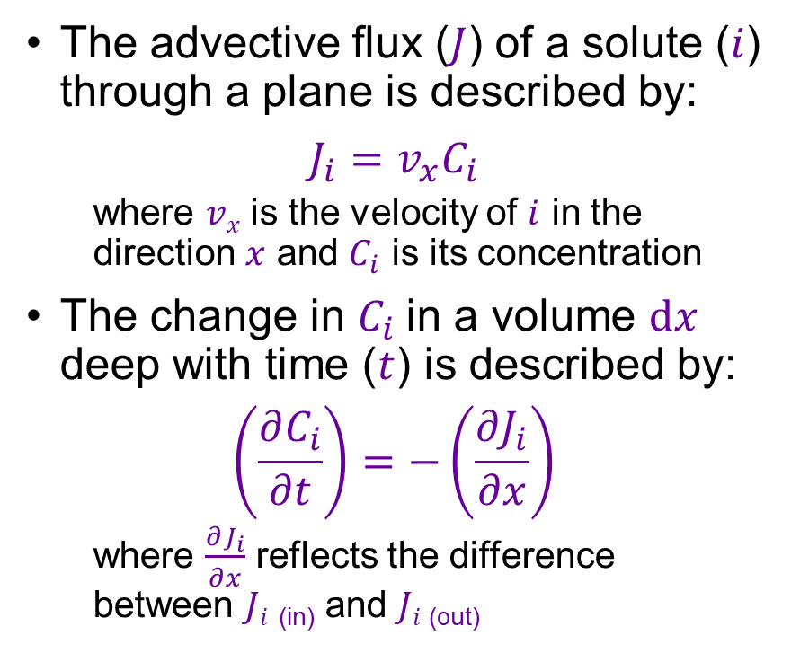
Advective flux
The advective flux ($J$) of a solute ($i$) through a plane is described by:
$$J_{i}=v_{x}C_{i}$$
  where $vx$ is the velocity of $i$ in the direction $x$ and $C_{i}$ is its concentration
The change in $C_{i}$in a volume $dx$ deep with time ($t$) is described by:
$$\left(\frac{∂C_{i}}{∂t}\right)=−\left(\frac{∂J_{i}}{∂x}\right)$$
  where $\frac{∂J_{i}}{∂x}$ reflects the difference between $Ji$ _{(in)} and $Ji$ _{(out)}
Change in flux with distance

Slide 22
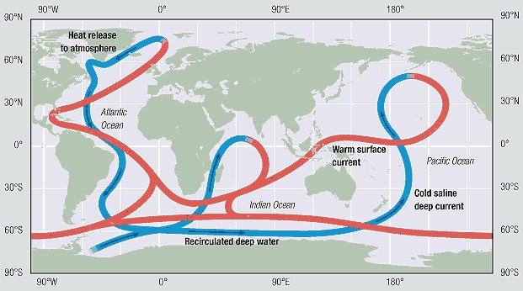
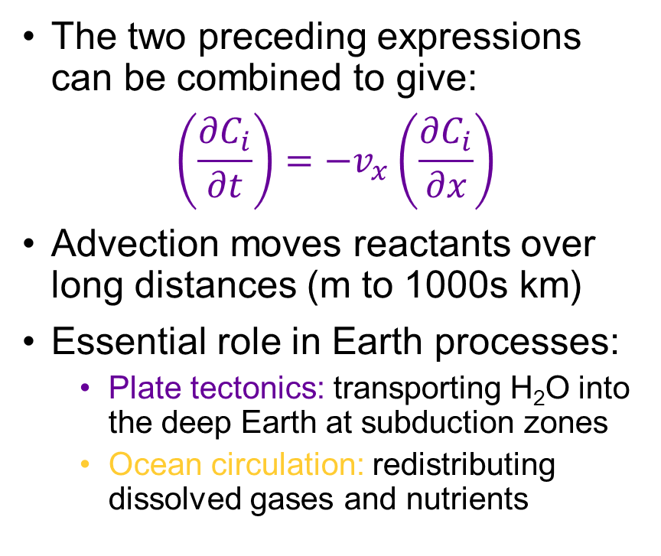
Advective mass transfer on Earth
The two preceding expressions can be combined to give:
$$\left(\frac{∂C_{i}}{∂t}\right)=−v_{x}\left(\frac{∂C_{i}}{∂x}\right)$$
Advection moves reactants over long distances (m to 1000s km)
Essential role in Earth processes:
  Plate tectonics: transporting H₂O into the deep Earth at subduction zones
  Ocean circulation: redistributing dissolved gases and nutrients

Slide 23
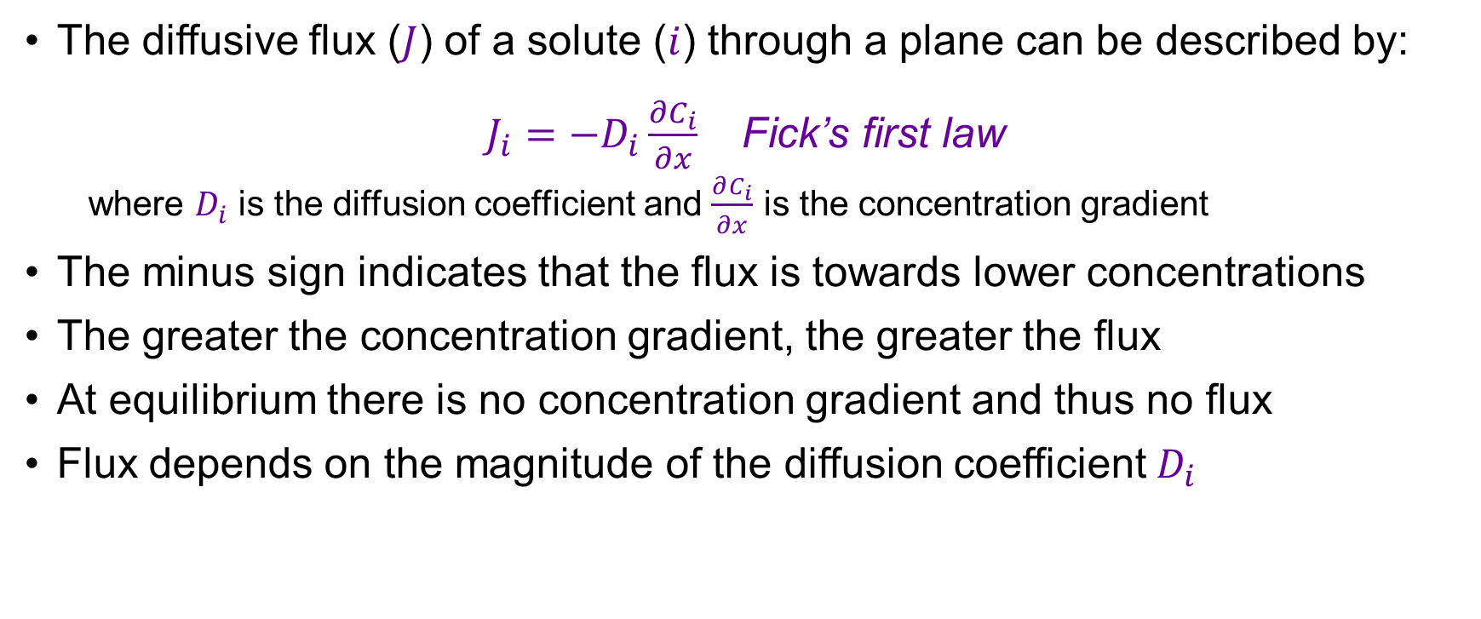
Diffusive flux and Fick’s first law
The diffusive flux ($J$) of a solute ($i$) through a plane can be described by:
$J_{i}=−D_{i}\frac{∂C_{i}}{∂x}$ Fick’s first law
  where $D_{i}$ is the diffusion coefficient and $\frac{∂C_{i}}{∂x}$ is the concentration gradient
The minus sign indicates that the flux is towards lower concentrations
The greater the concentration gradient, the greater the flux
At equilibrium there is no concentration gradient and thus no flux
Flux depends on the magnitude of the diffusion coefficient $D_{i}$
The partition coefficient $D$ should not be confused with the diffusion coefficient $D$!
Context should make it clear which $D$ applies

Slide 24

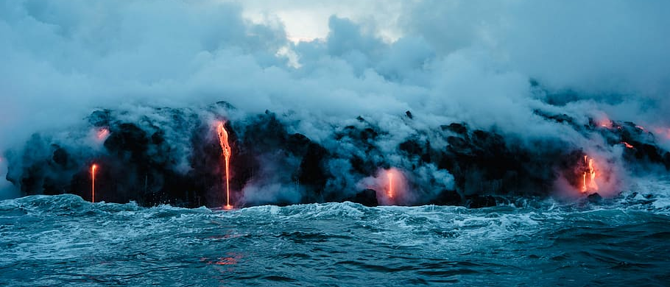
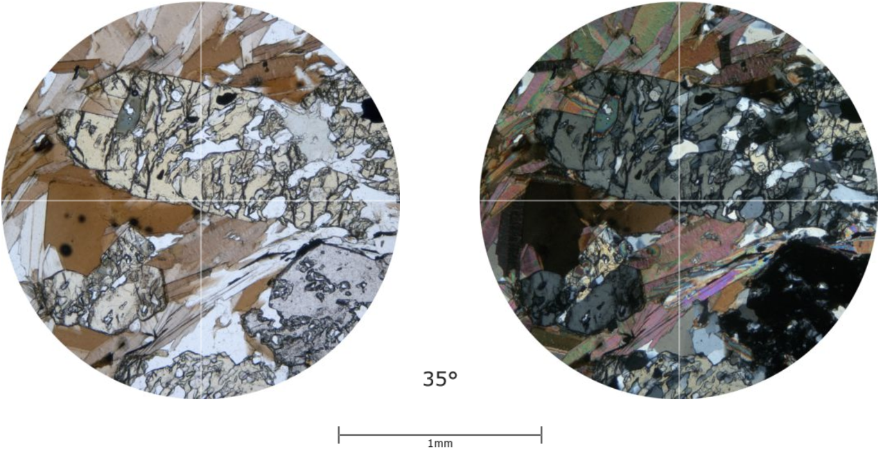
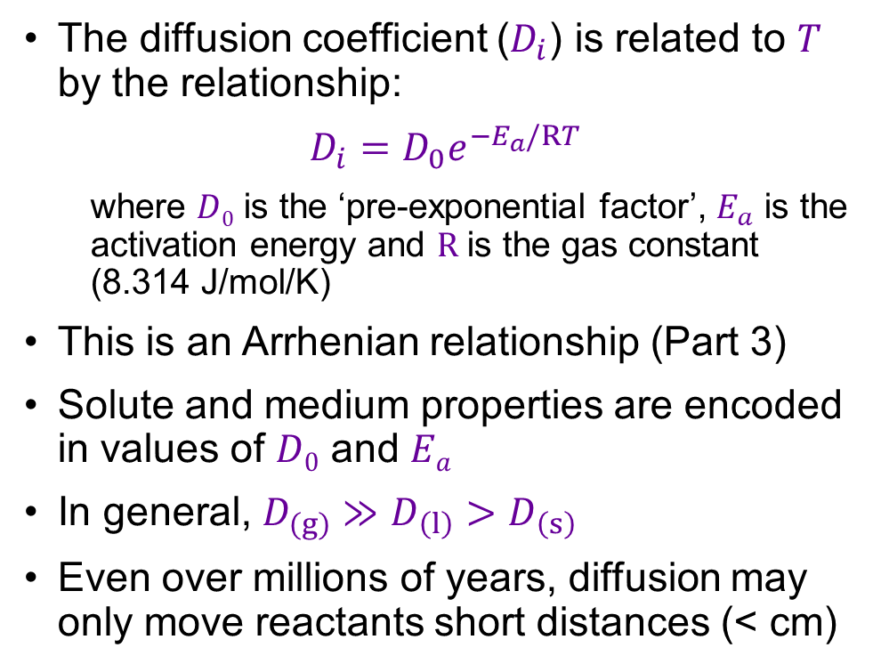
Diffusion coefficients
The diffusion coefficient ($D_{i}$) is related to $T$ by the relationship:
$$D_{i}=D_{0}e^{−E_{a}/RT}$$
  where $D0$ is the ‘pre-exponential factor’, $E_{a}$ is the activation energy and $R$ is the gas constant (8.314 J/mol/K)
This is an Arrhenian relationship (Part 3)
Solute and medium properties are encoded in values of $D0$ and $Ea$
In general, $D_{(g)}≫D_{\left(l\right)}>D_{\left(s\right)}$
Even over millions of years, diffusion may only move reactants short distances (< cm)

Slide 25
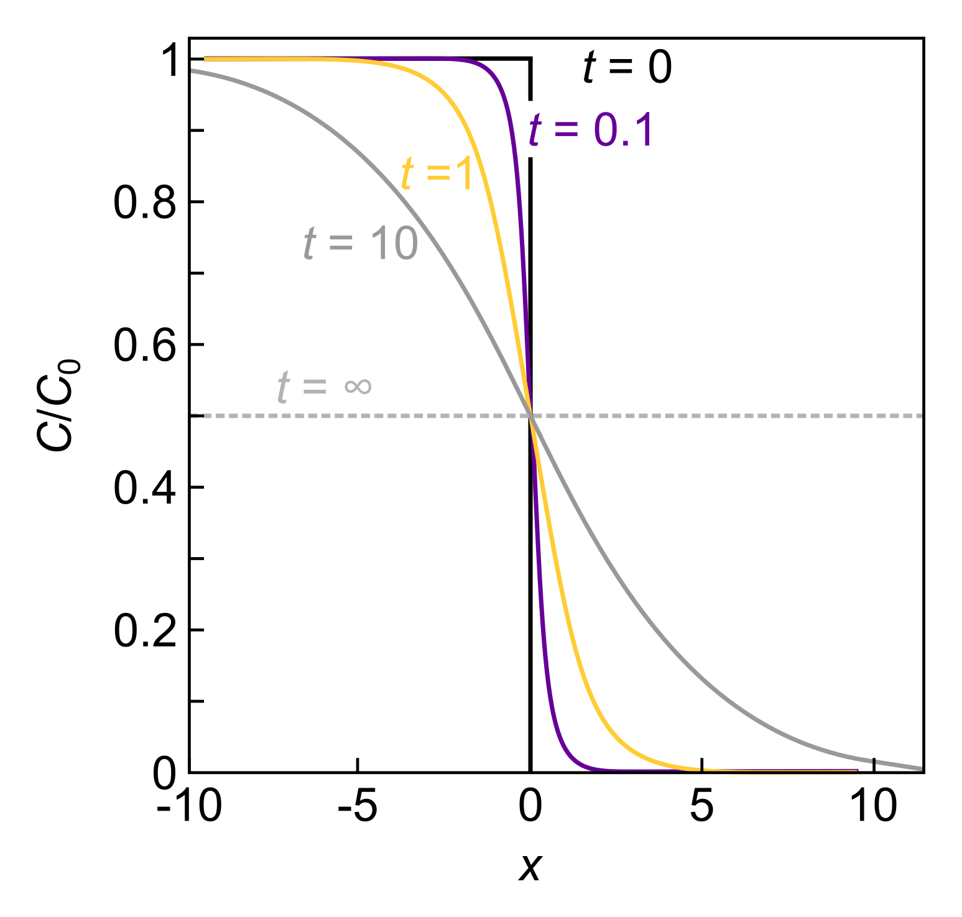
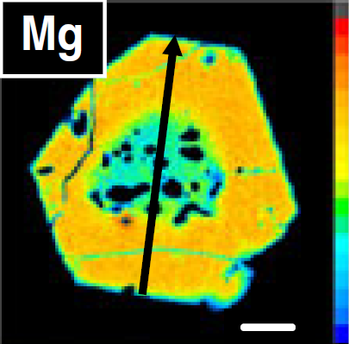
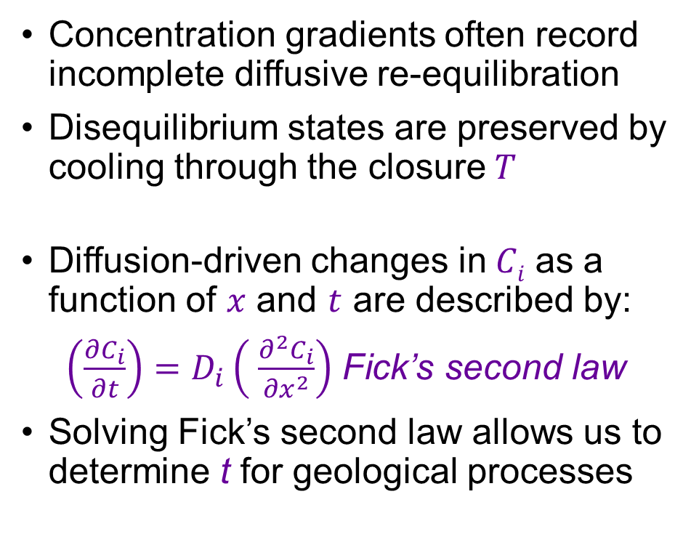

Diffusion profiles and Fick’s second law
Concentration gradients often record incomplete diffusive re-equilibration
Disequilibrium states are preserved by cooling through the closure$T$
Diffusion-driven changes in$Ci$ as a function of $x$ and $t$ are described by:
$\left(\frac{∂C_{i}}{∂t}\right)=D_{i}\left( \frac{∂^{2}C_{i}}{∂x^{2}}\right)$ Fick’s second law
Solving Fick’s second law allows us to determine t for geological processes
$T$ below which little diffusion occurs
Solving Fick’s second law is rarely straightforward

Slide 26
The pace of geochemical processes: kinetics and diffusion
EART26201 | Principles of Geochemistry | Lecture 5
Part 5 | Estimating the timescales of magmatic processes

Slide 27
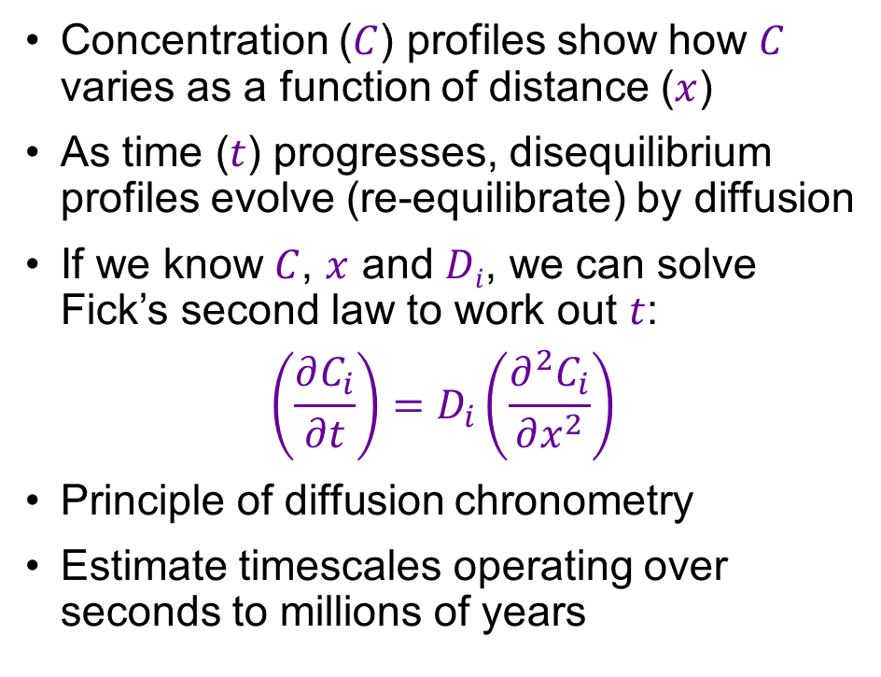
Concentration profiles record information about time
Concentration ($C$) profiles show how $C$ varies as a function of distance ($x$)
As time ($t$) progresses, disequilibrium profiles evolve (re-equilibrate) by diffusion
If we know $C$, $x$ and $Di$, we can solve Fick’s second law to work out $t$:
$$\left(\frac{∂C_{i}}{∂t}\right)=D_{i}\left(\frac{∂^{2}C_{i}}{∂x^{2}}\right)$$
Principle of diffusion chronometry
Estimate timescales operating over seconds to millions of years

Slide 28
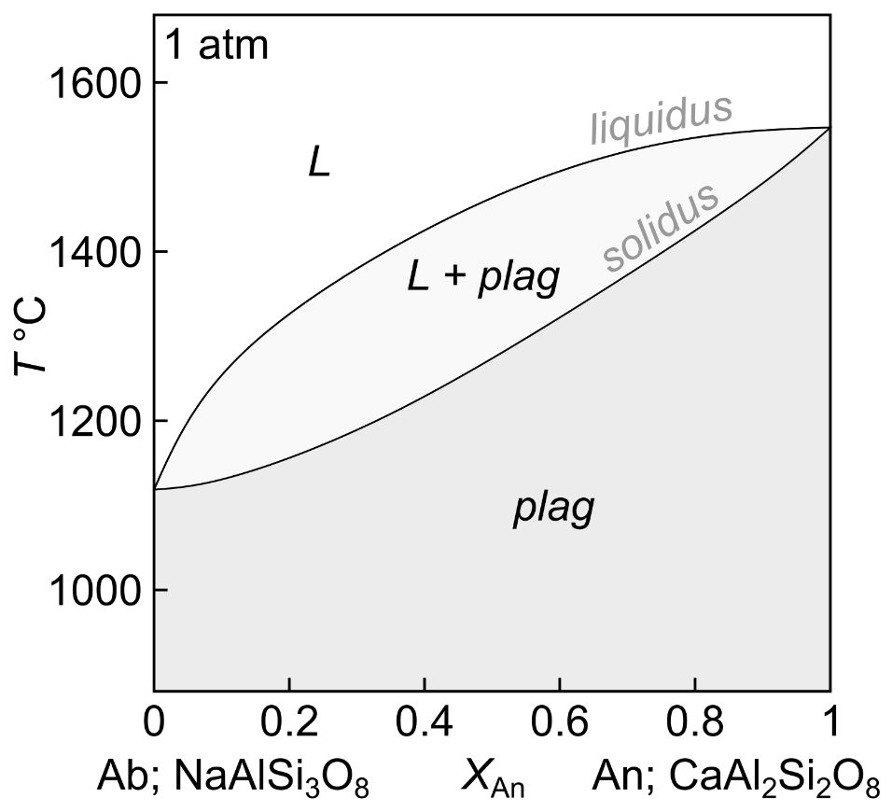
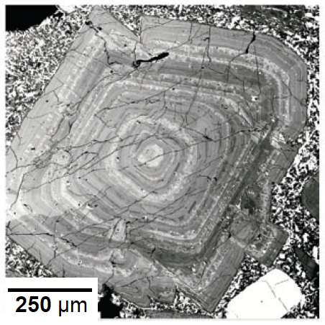
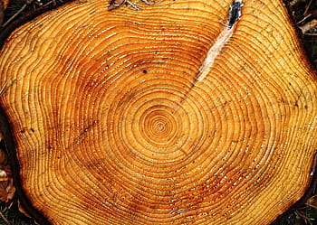
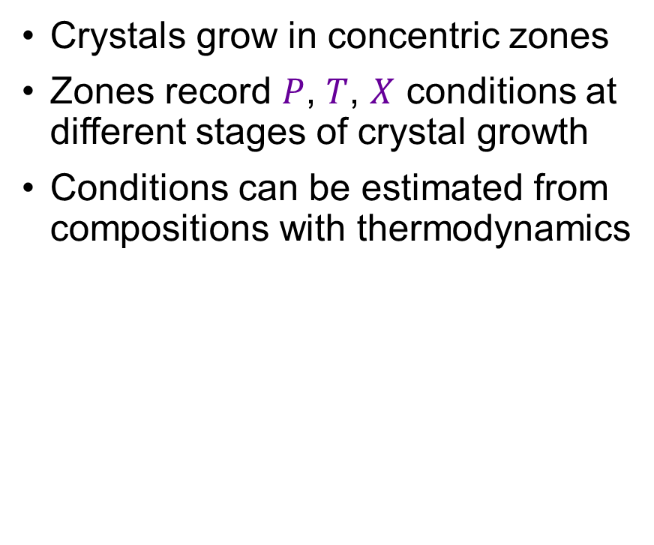
Concentration profiles in magmatic samples
Crystals grow in concentric zones
Zones record $P$, $T$, $X$ conditions at different stages of crystal growth
Conditions can be estimated from compositions with thermodynamics
Blundy & Cashman (2013)
Crystal stratigraphy

Slide 29
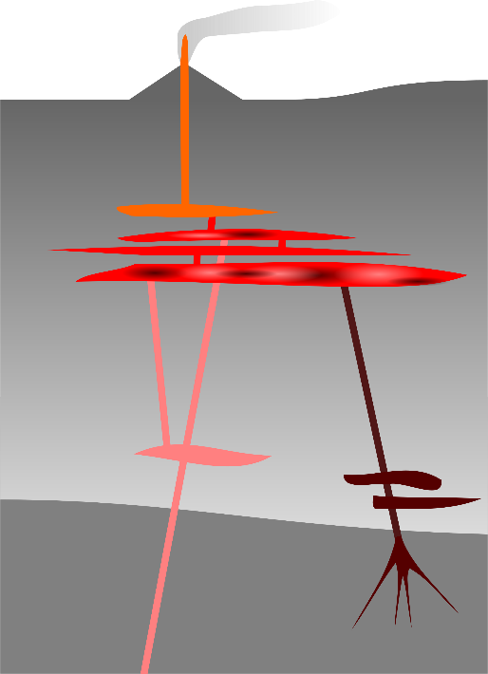
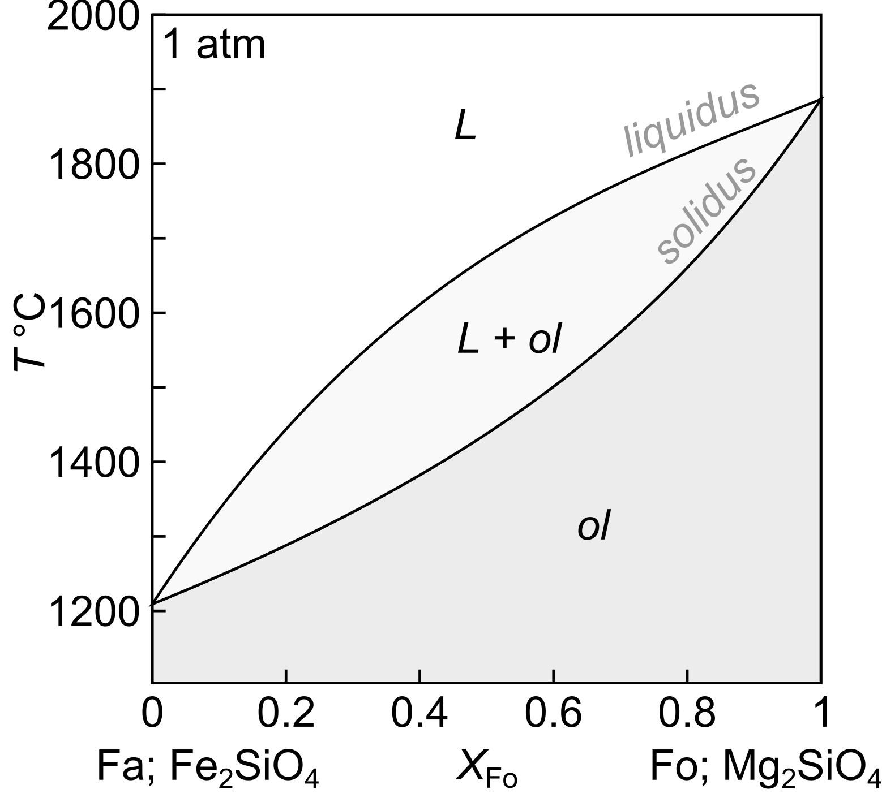
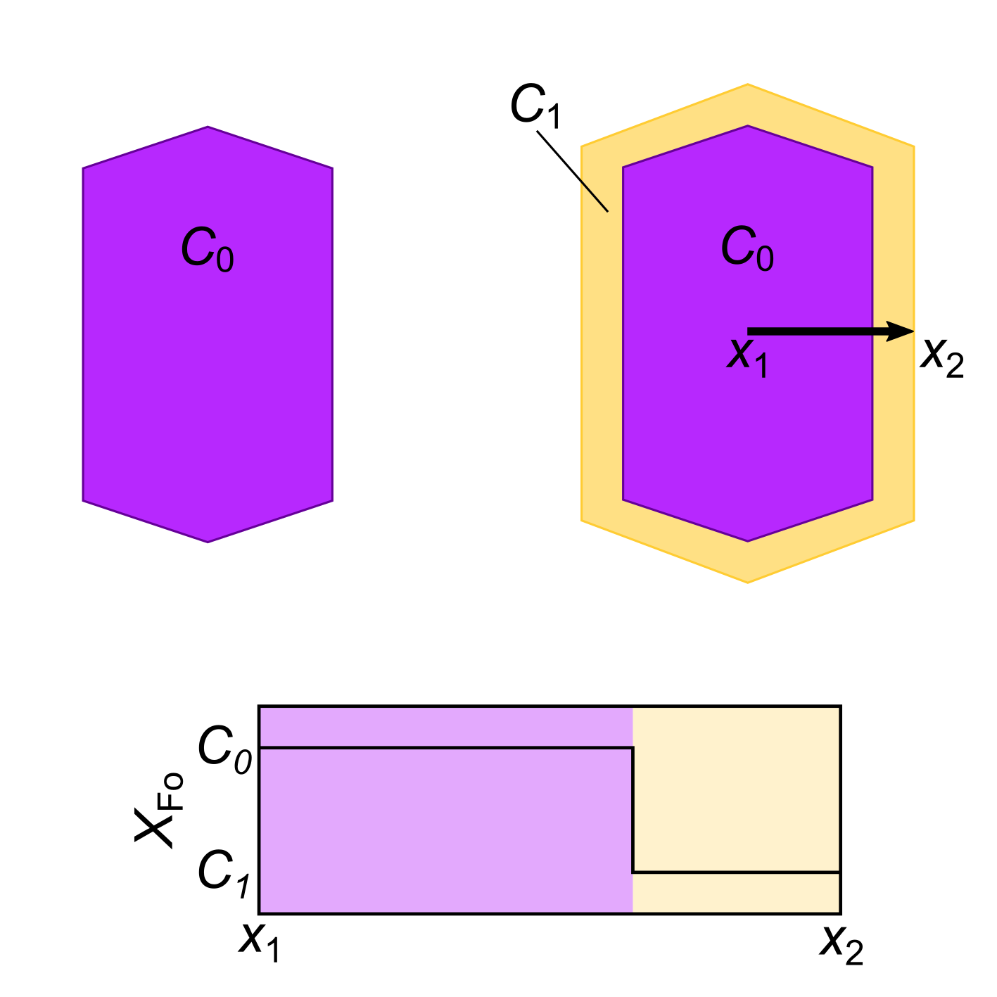
Mg–Fe zoning in olivine: growth of crystal zones

Slide 30
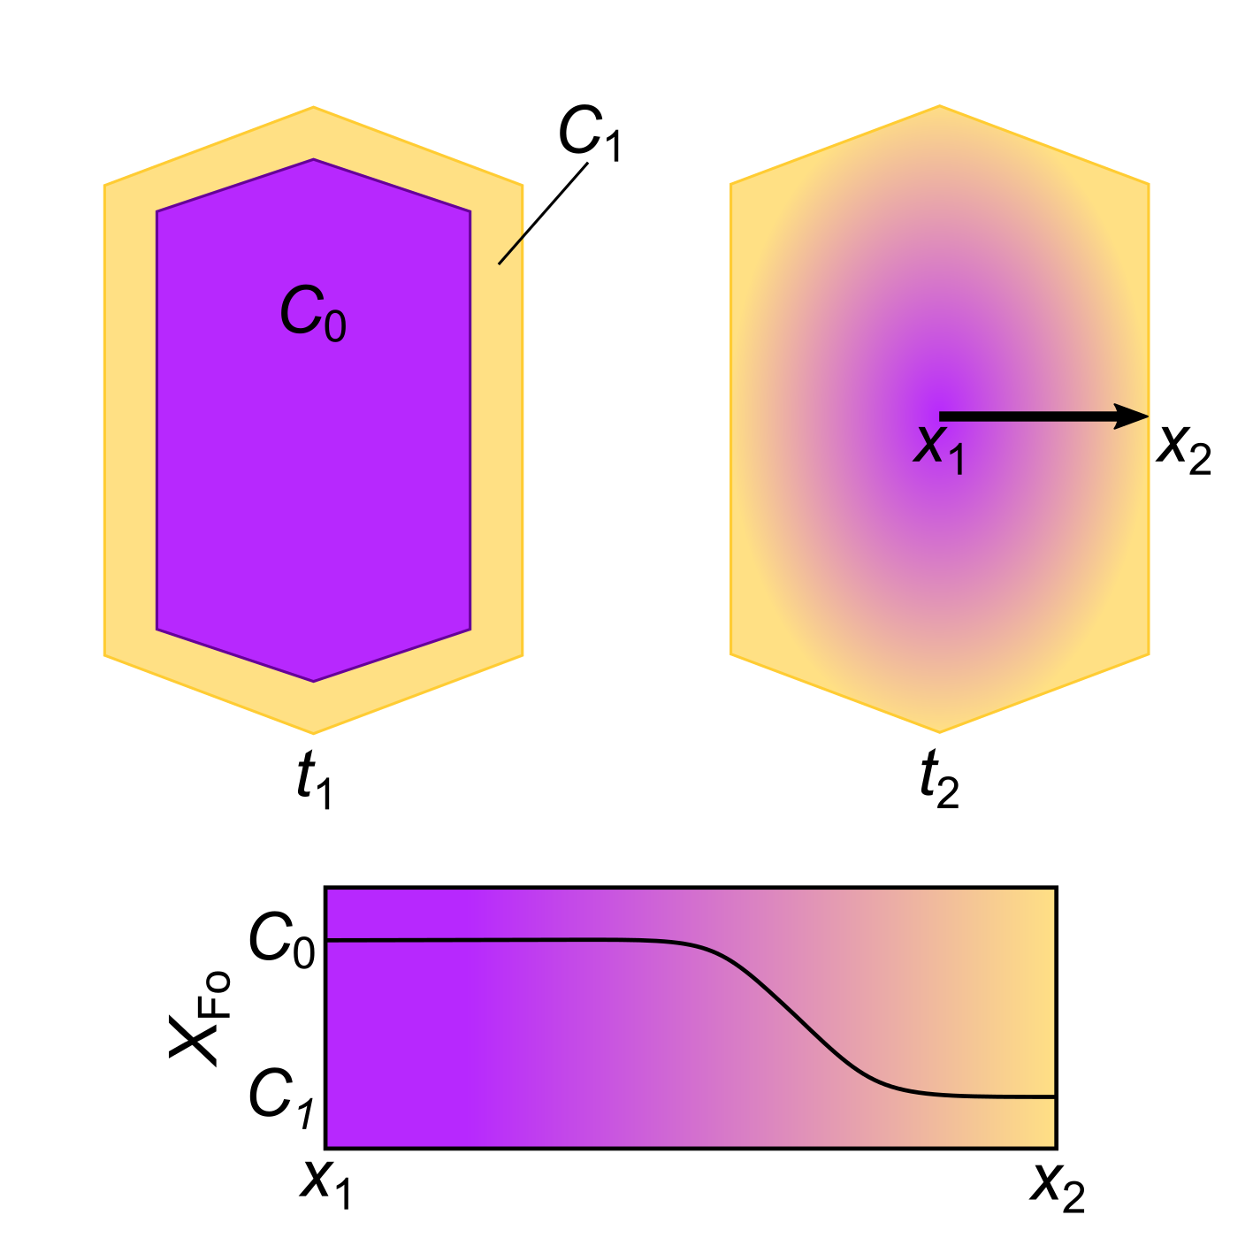
Mg–Fe zoning in olivine: diffusion of crystal zones

Slide 31
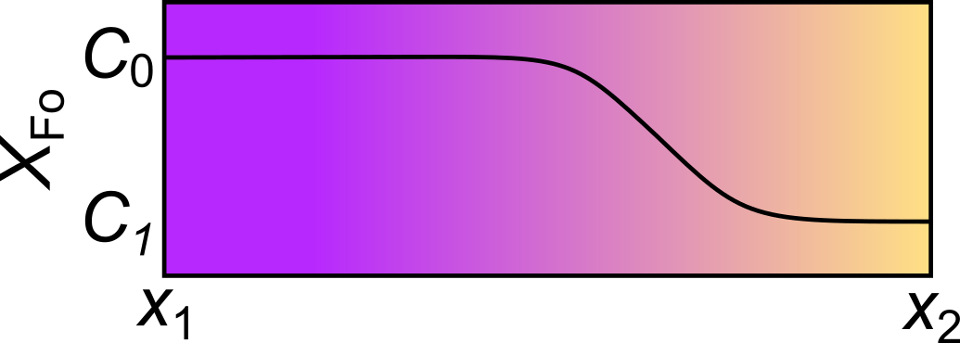
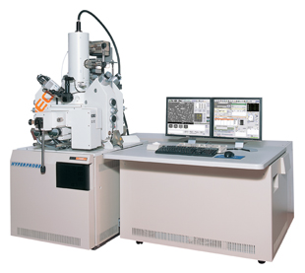

Mg–Fe zoning in olivine: estimating timescales
Measure profile to determine the relationship between $CFo$ and $x$
Electron microprobe: X-ray spectroscopy at the µm scale
Calculate $DFo$ (assuming $T$ and $P$)
Solve Fick’s second law for $t$:
$$\left(\frac{∂C_{Fo}}{∂t}\right)=D_{Fo}\left(\frac{∂^{2}C_{Fo}}{∂x^{2}}\right)$$
Solutions are usually obtained numerically (i.e. with a computer)

Slide 32





Mg–Fe zoning in olivine: 1783–84 Laki Fires, Iceland
Largest documented eruption in Europe
Olivines record mixing with cooler melts only 6–10 days before eruption
Little warning of future eruptions?
Hartley et al. (2016)

Slide 33




Mg–Fe zoning in olivine: Etna, Italy
Most active volcano in Europe
Some olivines record recharge by hotter melts ~40 days before eruption
Magma recharge may trigger eruptions
Catania, pop. 300k
Kahl et al. (2013)

Slide 34



But magma plumbing systems may be more complex

